Slide 1
statistical processes for personalized medicine
Jeff Leek
Johns Hopkins Bloomberg Biostatistics

Slide 2

share my talk!
You are free to:
Talk at: https://github.com/jtleek/talks
Provided:
Provided you attribute this work to its author and respect the rights and licenses associated with its components
Copy, share adapt and remix
Photograph, film and broadcast
Live tweet, blog, post video of
Adapted from: http://bit.ly/WUa0tx

Slide 3
demo (roger convinced me this would be a good idea)

Slide 4
take home messages
Methods for going from data to signature
Can/should we make this automatic?

Slide 5
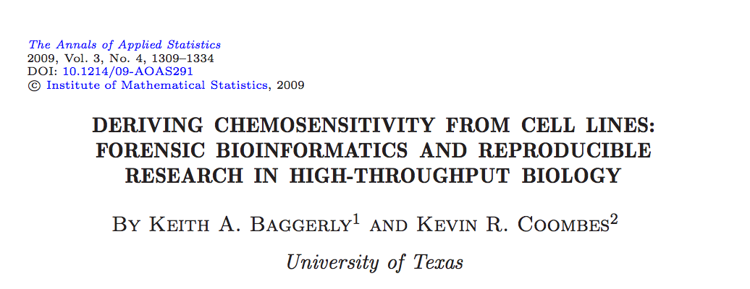
an example we all know

Slide 6
what were the problems?
irreproducibility
lack of cooperation
silly prediction rules
study design/batch effects
procedures not locked down
Transparency
Expertise

Slide 7
reproducibility

Slide 8
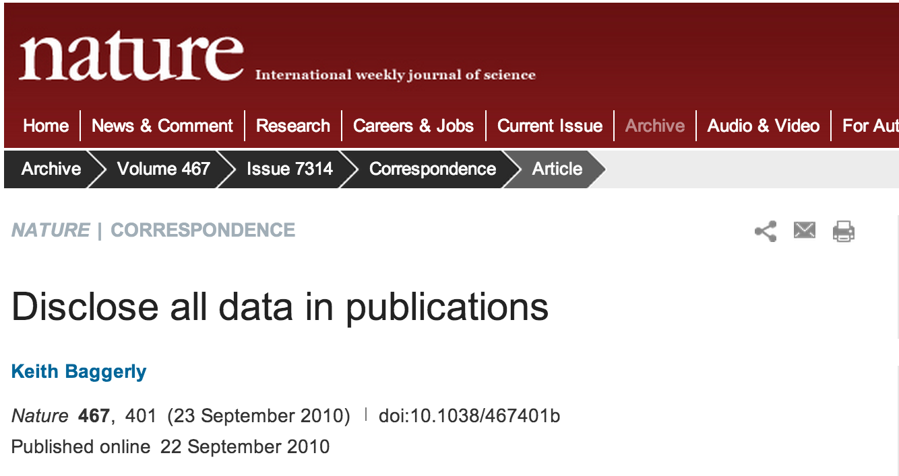
going the right direction

Slide 9
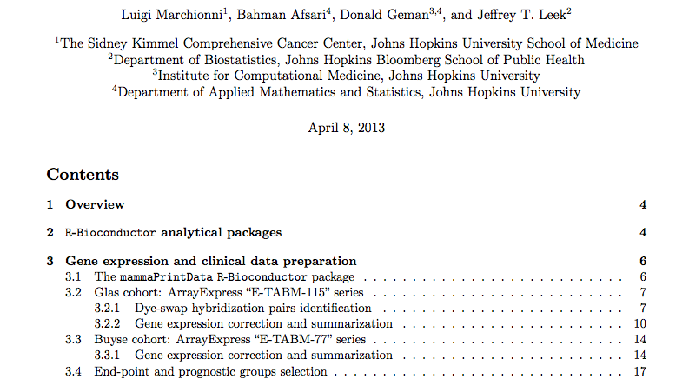
a reproducible research success story*
http://www.biomedcentral.com/content/supplementary/1471-2164-14-336-s1.pdf
http://astor.som.jhmi.edu/~marchion//breastTSP.html

Slide 10
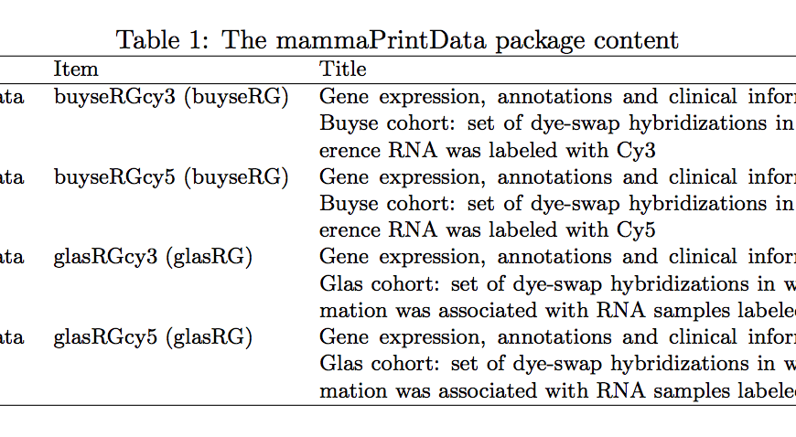
mammaprint data sets
http://astor.som.jhmi.edu/~marchion//breastTSP.html

Slide 11
transparency

Slide 12
*
Thank you for sharing the paper with us prior to publication. We discussed the publication internally and we feel that it is a very nice publication and would like you to proceed without uploading the excel file.

Slide 13
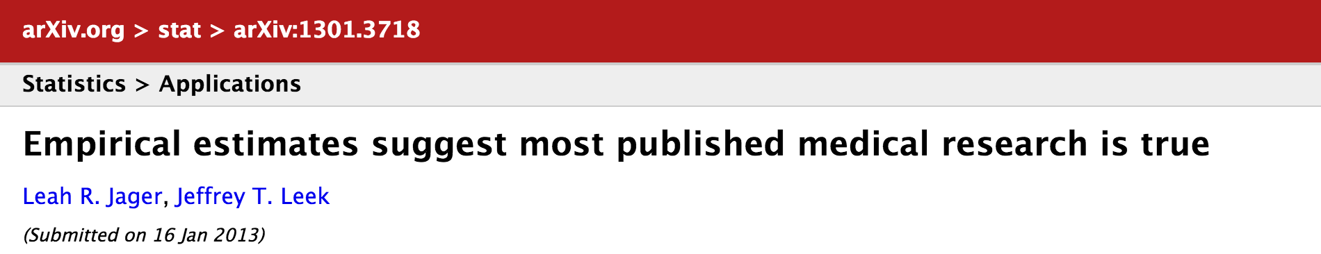
a digression
“However, the respective figure 3 panel (bottom I have compared several years/journals against what is shown in figure 3 panels and I get very different distributions. There is tons of things that are wrong with this paper, but at a minimum I would hope that the very basic numbers are correct.”

Slide 14
what were the problems?
irreproducibility
lack of cooperation
silly prediction rules
study design/batch effects
procedures not locked down
Transparency
Expertise

Slide 15
silly prediction rules

Slide 16
potti prediction rules
P(FTAC) = P(T) + P(F) + P(A) + P(C) – P(T)P(F)P(A)P(C)
P(ET) = max[P(E),P(T)]
P(FEC) = 5/8[P(F) + P(E) + P(C)] – 1/4
Baggerly et al. AOAS 2009

Slide 17
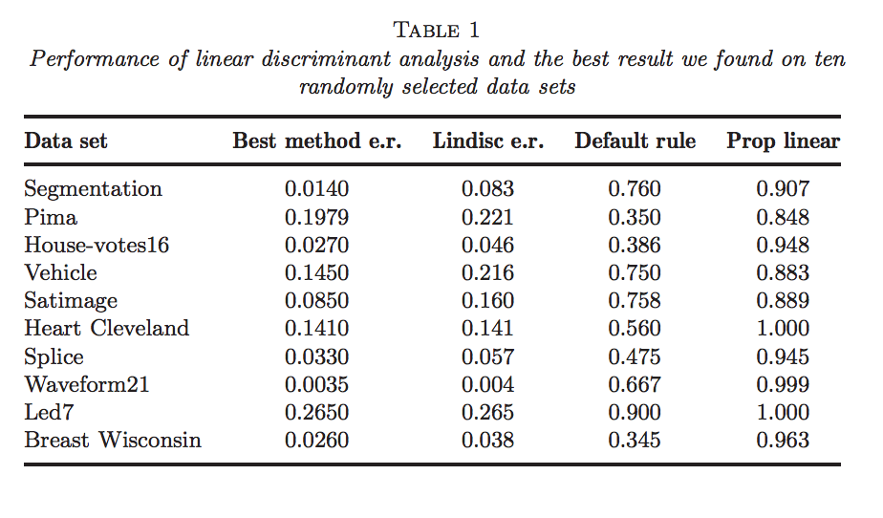
illusion of progress in ml
Hand Statistical Science 2006

Slide 18
one stupidly simple predictor
Leek Bioinformatics 2009

Slide 19
comparably accurate
Adapted from Geman et al. SAGMB 2004

Slide 20
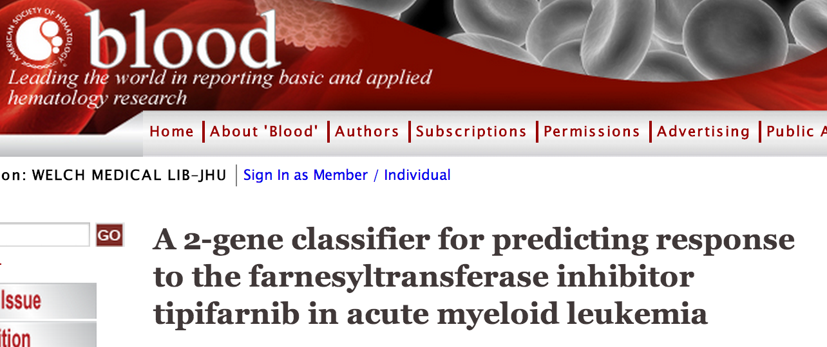
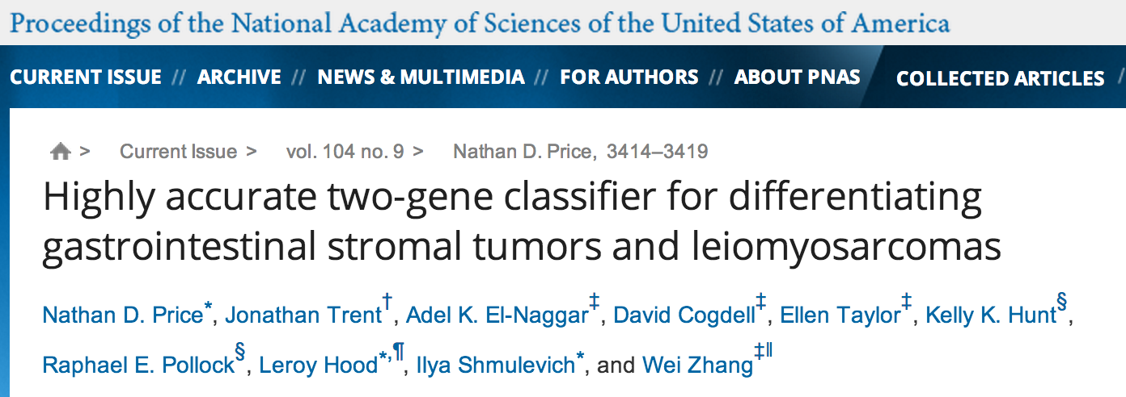
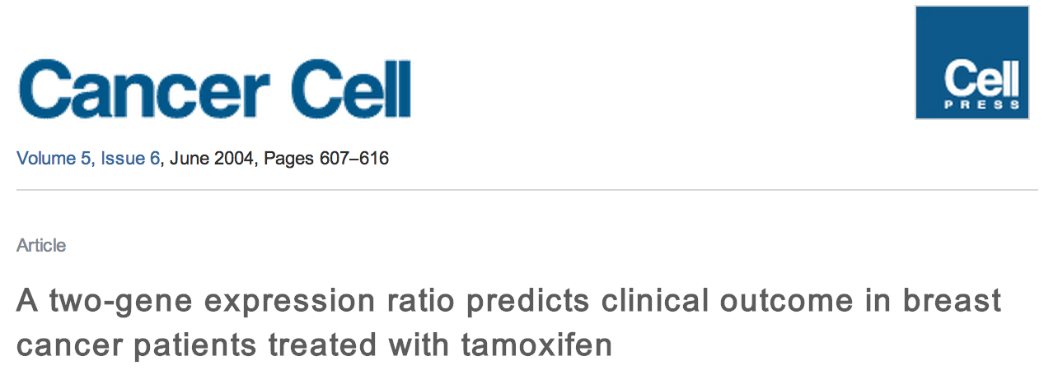
some success

Slide 21
top scoring pairs
Data:
x_{ik} - value for feature i, sample k
y_{k} - group indicator for sample k
TSP is (i,j) pair that maximizes:
⌃
⌃
|Pr(x_{ik} < x_{jk} | y_{k}=1) – Pr(x_{ik} < x_{jk} | y_{k}=0)|
Geman et al. SAGMB 2004

Slide 22
regression framework
z_{ijk}=1(x_{ik} < x_{jk})
E[z_{ijk}|y_{k}] = a_{0ij} + a_{1ij}y_{k}
→ max |a_{1jk}| = TSP
Patil et al. in prep

Slide 23
flip the regression
Not the same as TSP
But |â/s.e.(â)| = |û/s.e.(û)|, algebraically
“Variance regularized” TSP
z_{ijk} invariant to monotone transformations
Fix parameters → find features
E[y_{k}|z_{ijk}] = u_{0ij} + u_{1ij}z_{ijk}
Patil et al. in prep

Slide 24
tsp-regression algorithm
Calculate t-statistic for all pairs
Choose top k pairs
Score for sample i is ∑sign(u_{1ij})z_{ijk} for pairs
E[y_{k}|z_{ijk}] = u_{0ij} + u_{1ij}z_{ijk}
Patil et al. in prep

Slide 25
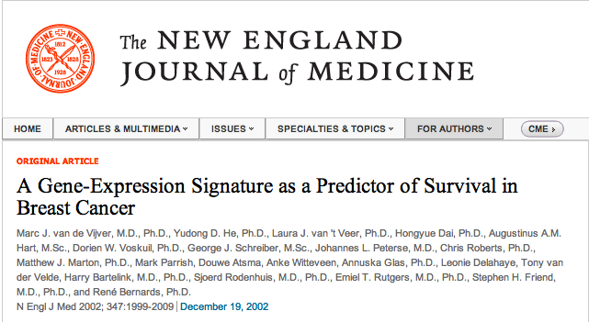

a very successful genomic signature

Slide 26
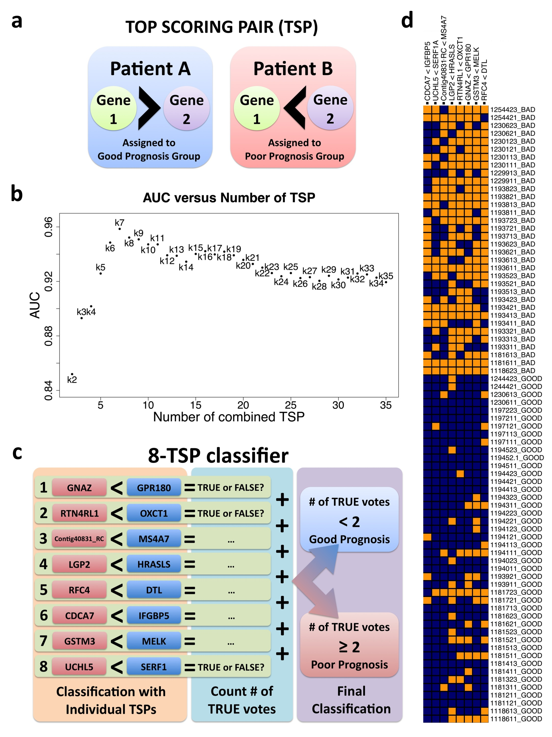
mammaprint alternative
Marchionni et al. BMC Genomics 2013

Slide 27
survival tsp
Cox regression
Pick max log hazard ratio |û/s.e.(û)|
Alternatives – max logrank, etc.
h(t|z_{ijk}) =h_{o}(t) exp(u_{0ij} + u_{1ij}z_{ijk})
Patil et al. in prep

Slide 28
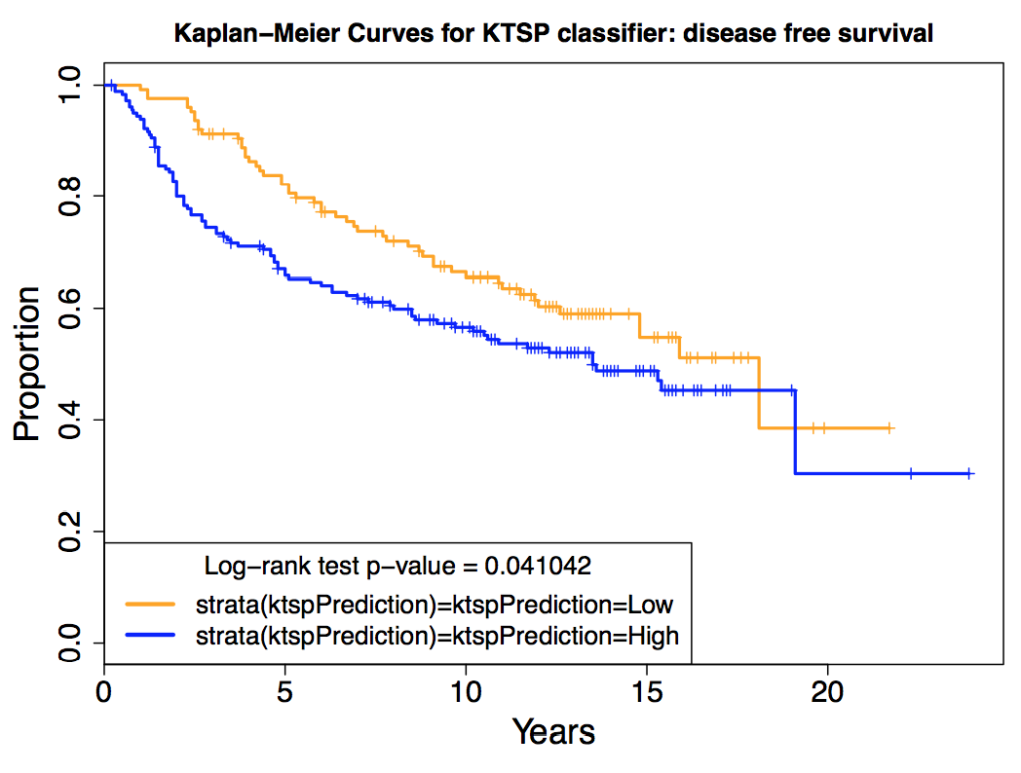
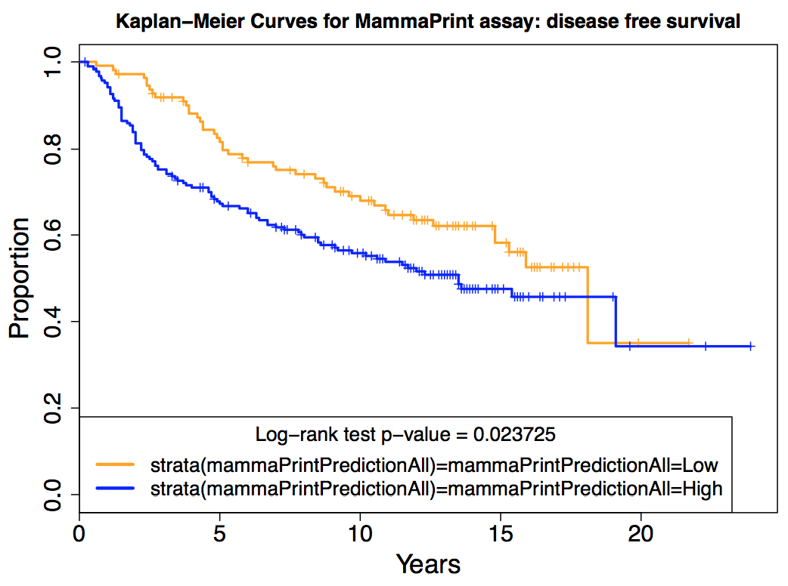
survival comparison
ktsp
mammaprint
Marchionni et al. BMC Genomics 2013

Slide 29
batch effects

Slide 30

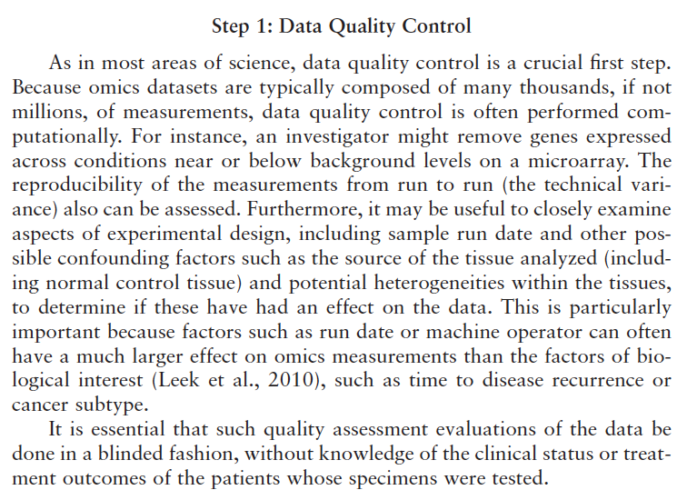
iom report

Slide 31
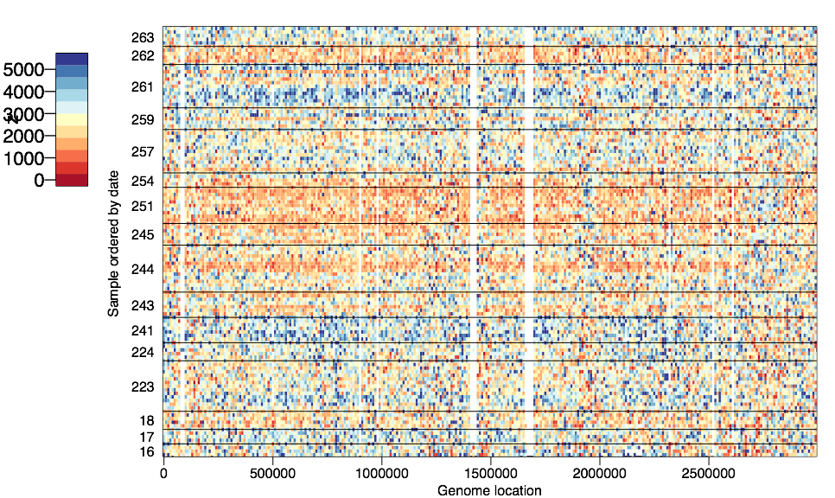
1000 genomes exome coverage (quantile normalized)
Leek et al. Nat. Rev. Genetics 2010

Slide 32
batch effects
Higher coverage on certain days, even after normalization
Leek et al. Nat. Rev. Genetics 2010

Slide 33
what can happen

Slide 34
what can happen

Slide 35
surrogate variable analysis
We observe
samples
Group
Batch
Error
=
+
+
genes/transcripts/probes

Slide 36
surrogate variable analysis
We want to estimate
samples
Group
Batch
Error
=
+
+
genes/transcripts/probes

Slide 37
surrogate variable analysis
samples
Group
Batch
Error
=
+
+
genes/transcripts/probes
We need to find this part of the matrix

Slide 38
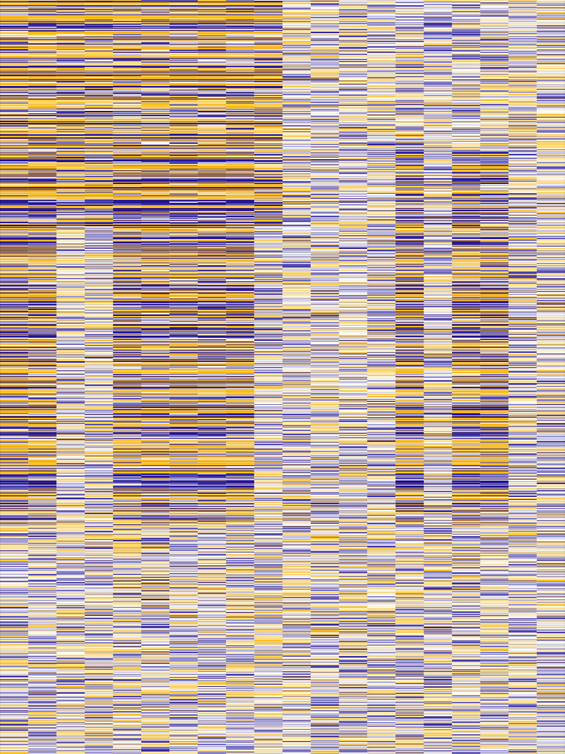

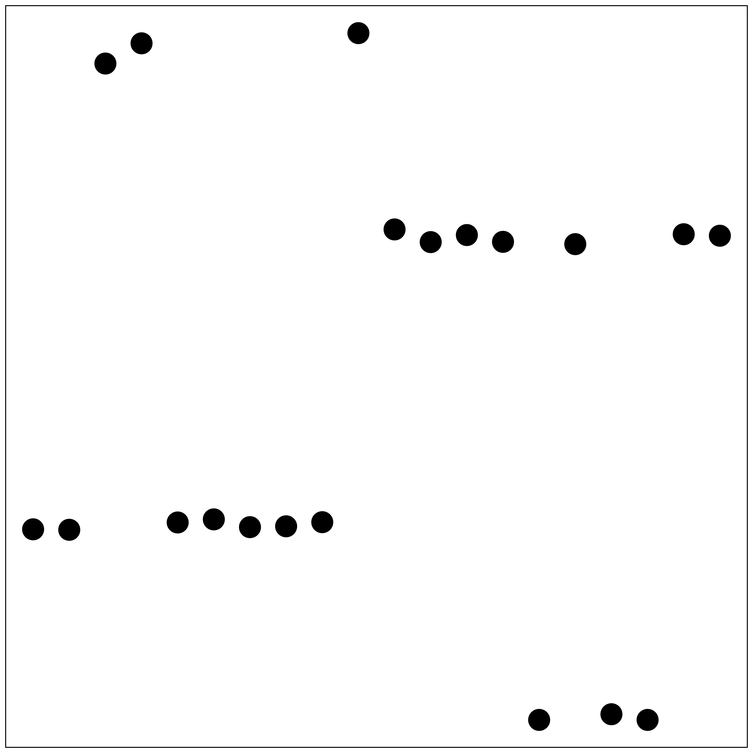

Data
Weight
Estimate of “Batch”
True “Batch”
Leek and Storey PLoS Genetics 2007, PNAS 2008

Slide 39

Data
Weight
Estimate of “Batch”
True “Batch”
Leek and Storey PLoS Genetics 2007, PNAS 2008

Slide 40
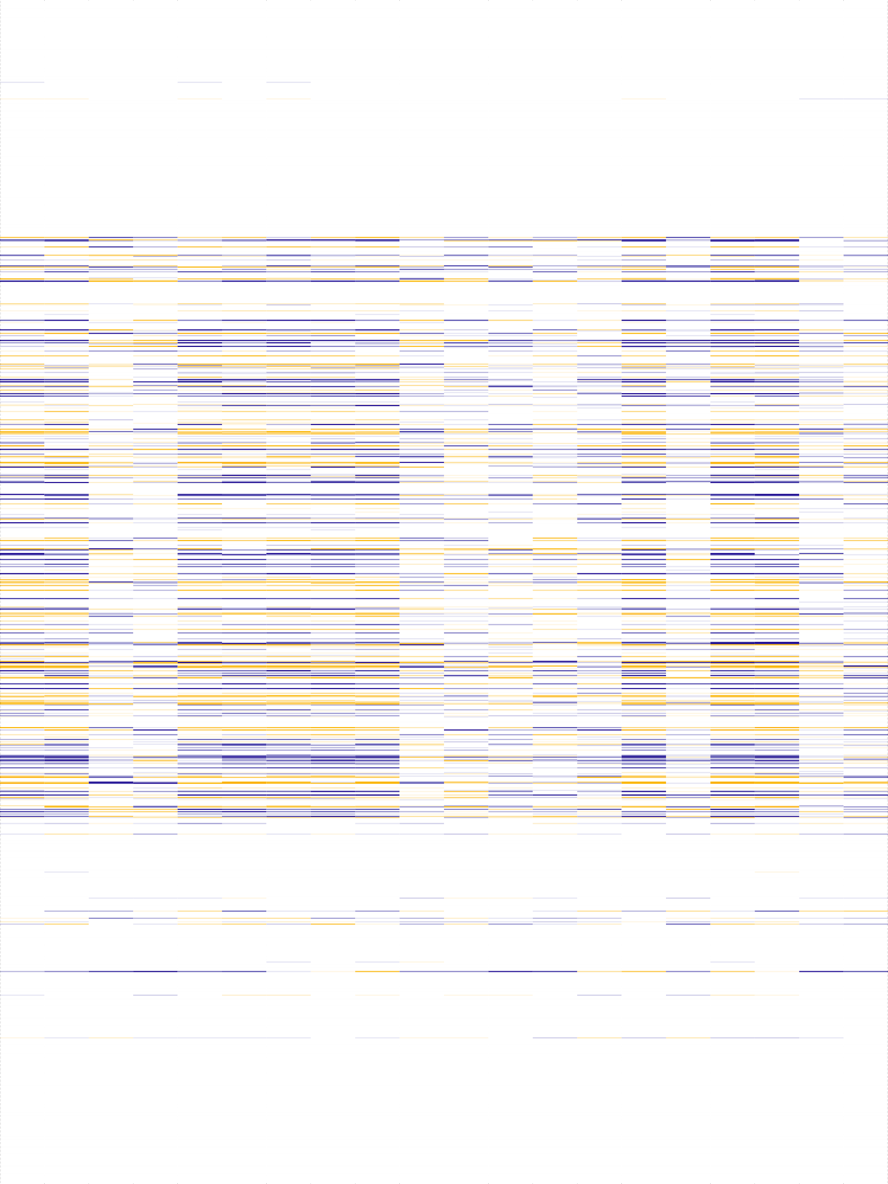
Data
Weight
Estimate of “Batch”
True “Batch”
Leek and Storey PLoS Genetics 2007, PNAS 2008

Slide 41
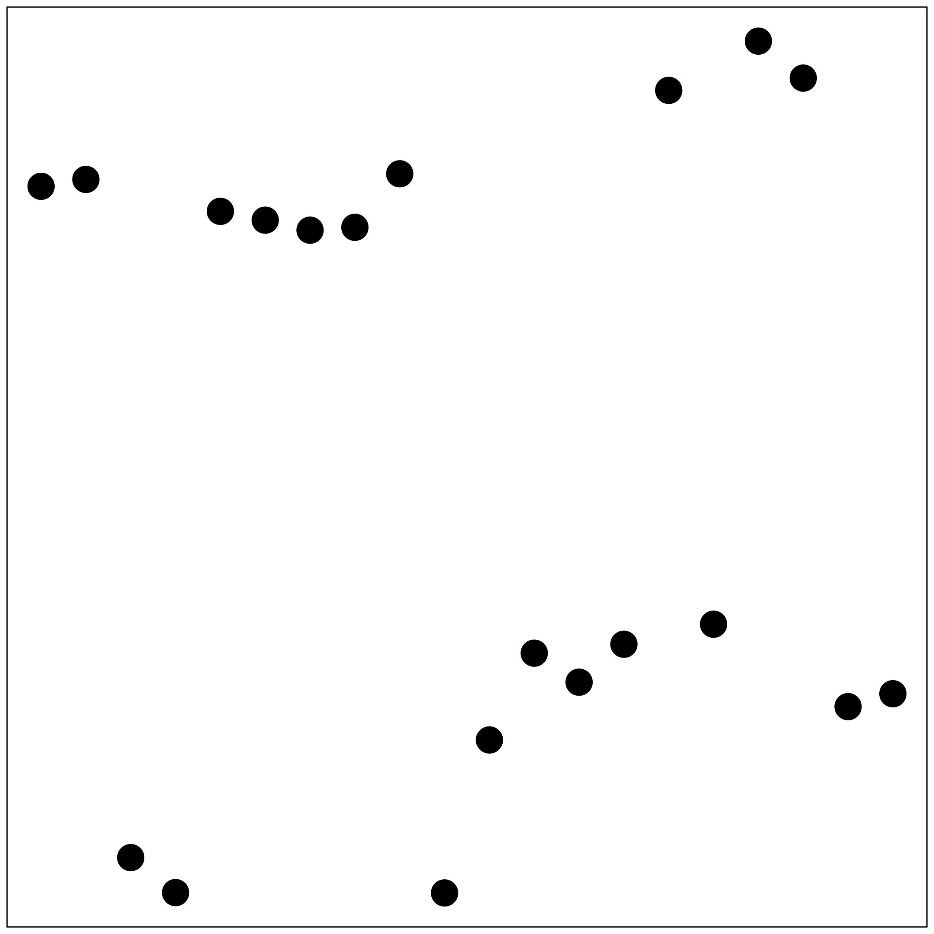
Data
Weight
Estimate of “Batch”
True “Batch”
Leek and Storey PLoS Genetics 2007, PNAS 2008

Slide 42

Data
Weight
Estimate of “Batch”
True “Batch”
Leek and Storey PLoS Genetics 2007, PNAS 2008

Slide 43
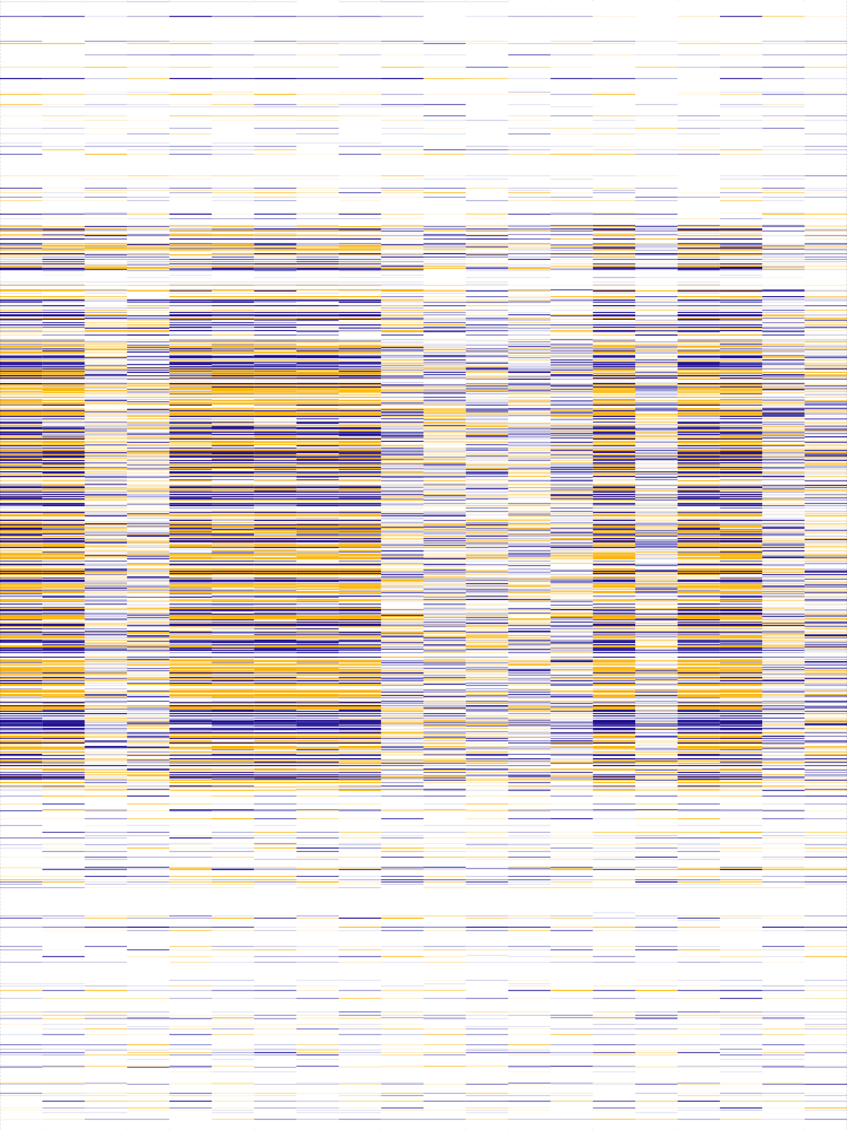
Data
Weight
Estimate of “Batch”
True “Batch”
Leek and Storey PLoS Genetics 2007, PNAS 2008

Slide 44
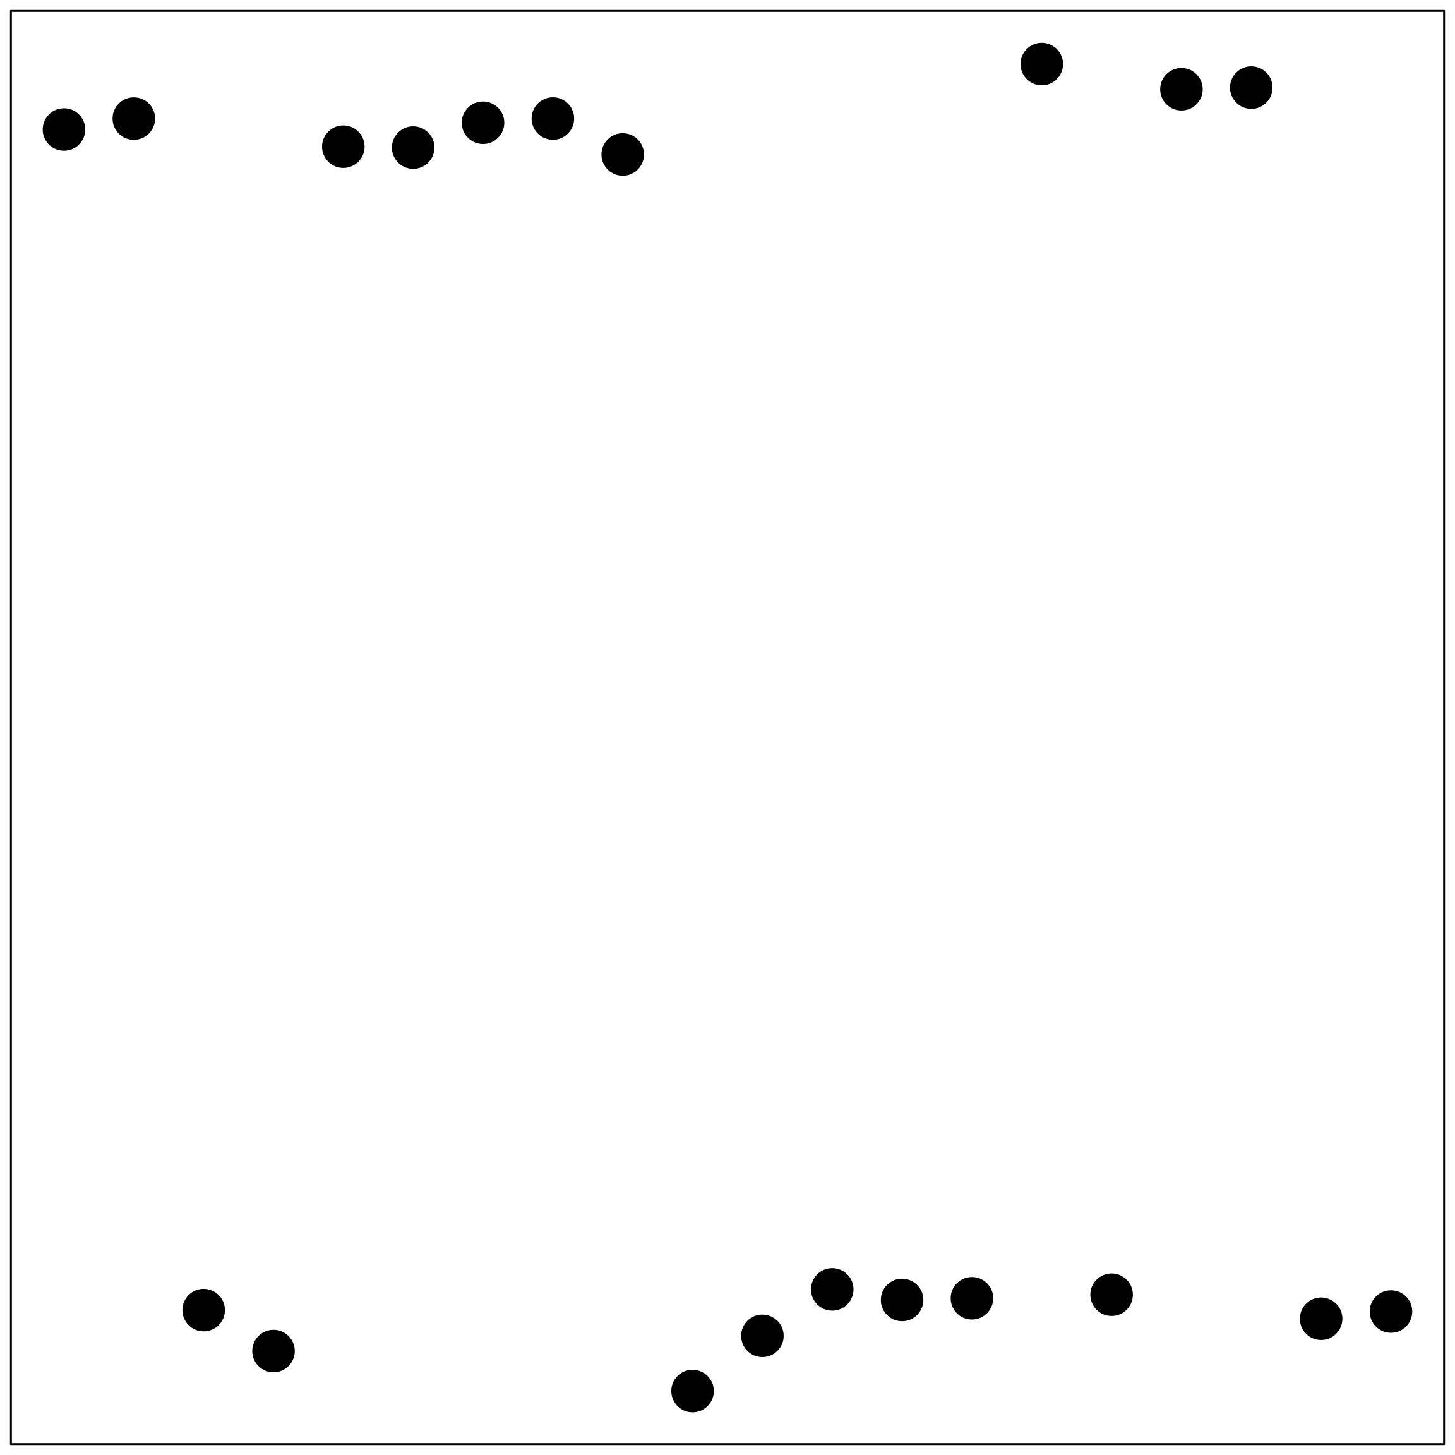
Data
Weight
Estimate of “Batch”
True “Batch”
Leek and Storey PLoS Genetics 2007, PNAS 2008

Slide 45
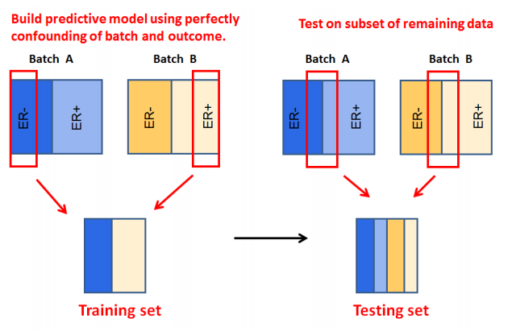
batch affects prediction
Parker and Leek SAGMB 2012

Slide 46
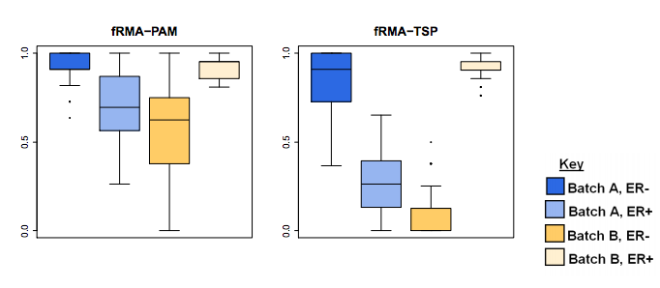
batch affects prediction
Parker and Leek SAGMB 2012

Slide 47
procedure lockdown

Slide 48
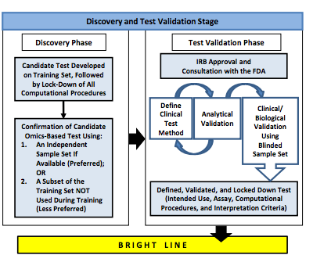
locking down procedures

Slide 49
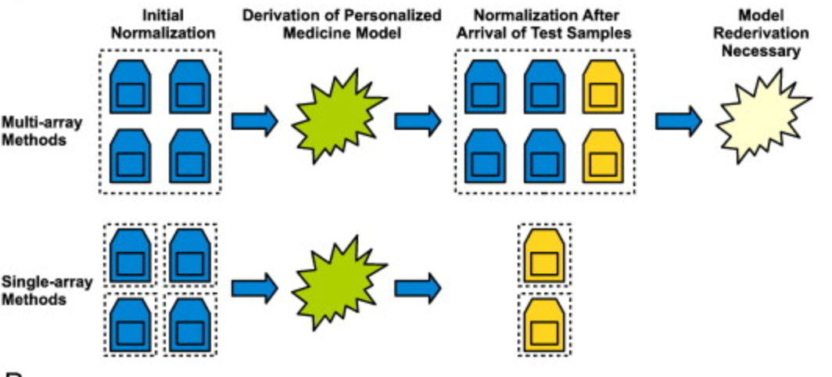
“freezing” preprocessing
Piccolo et al. Genomics 2013

Slide 50

example
Case: 50
Case: 50 + 1
Case: 50 + 5

Slide 51
preprocess all together
Case: 50
Case: 50 + 1
Case: 50 + 5

Slide 52
d.e. on only first 50
Case: 50
Case: 50 + 1
Case: 50 + 5

Slide 53
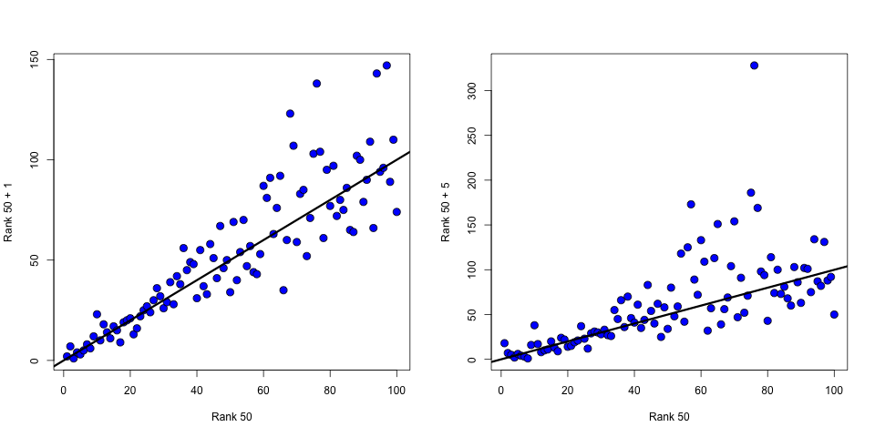
ranks of de genes

Slide 54
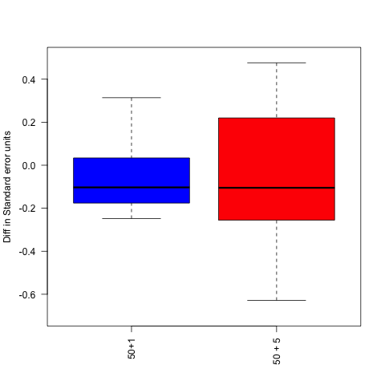
change in top 100 coefficients
(coeff50 – coeff50+1)/s.e.(coeff50)

Slide 55
most batch corrections are population level
samples
Johnson et al. 2007, Walker et al. 2008, Scharpf et al. 2010, Leek and Storey 2007, 2008, Kang et al. 2008, Friguet et al. 2010, Stegle et al. 2010, Gagnon-Bartsch and Speed 2011, Sun et al. 2011, Jacob et al. 2012, Mostavi et al. 2013 …
Batch
Group
Genomics
Data

Slide 56
clinical applications – building a classifier
samples
Batch
?
Group
?
Genomics
Data
Single
Genomic
Sample
Parker and Leek Submitted

Slide 57
clinical applications –applying a classifier
samples
Batch
?
Group
?
Genomics
Data
Single
Genomic
Sample
Parker and Leek Submitted

Slide 58
frozen surrogate variable analysis
Step 1 Estimate weights, batch, and batch coefficients from the training set or another suitable database using
population level sva.
sva
Parker and Leek Submitted

Slide 59
frozen surrogate variable analysis
Step 2 Regress batch effects from the genomic data.
−
=
Parker and Leek Submitted

Slide 60
frozen surrogate variable analysis
Step 3 Build a predictor
on the clean data
Your favorite prediction algorithm
Parker and Leek Submitted

Slide 61
frozen surrogate variable analysis
Step 4 Append the new sample to the database. Weight by the probability
weights from sva and estimate batch for the new sample.
×
=
SVD of combined matrix
Parker and Leek Submitted

Slide 62
frozen surrogate variable analysis
Step 5 Apply the
coefficients estimated
from the database, subtract the batch effect,
and apply the classifier.
-
=
Parker and Leek Submitted

Slide 63
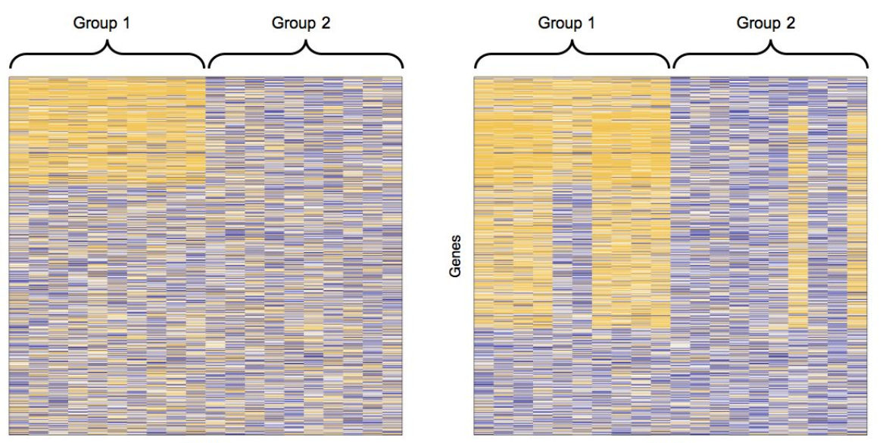
simulated example
No Batch
Batch
Genes
Genes
Arrays
Arrays
Parker and Leek Submitted

Slide 64
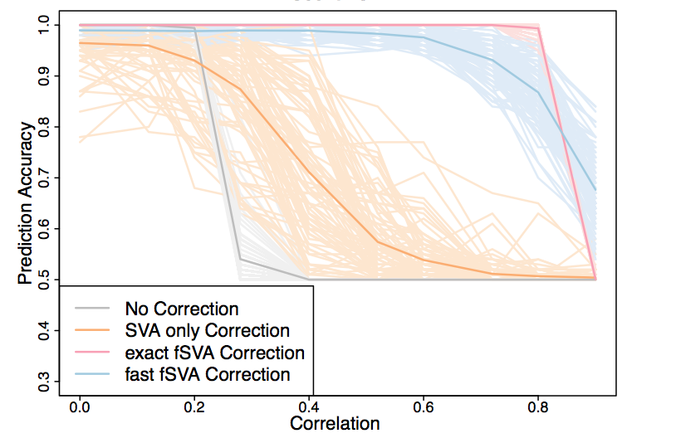
results
Parker and Leek Submitted

Slide 65
should we automate this?

Slide 66
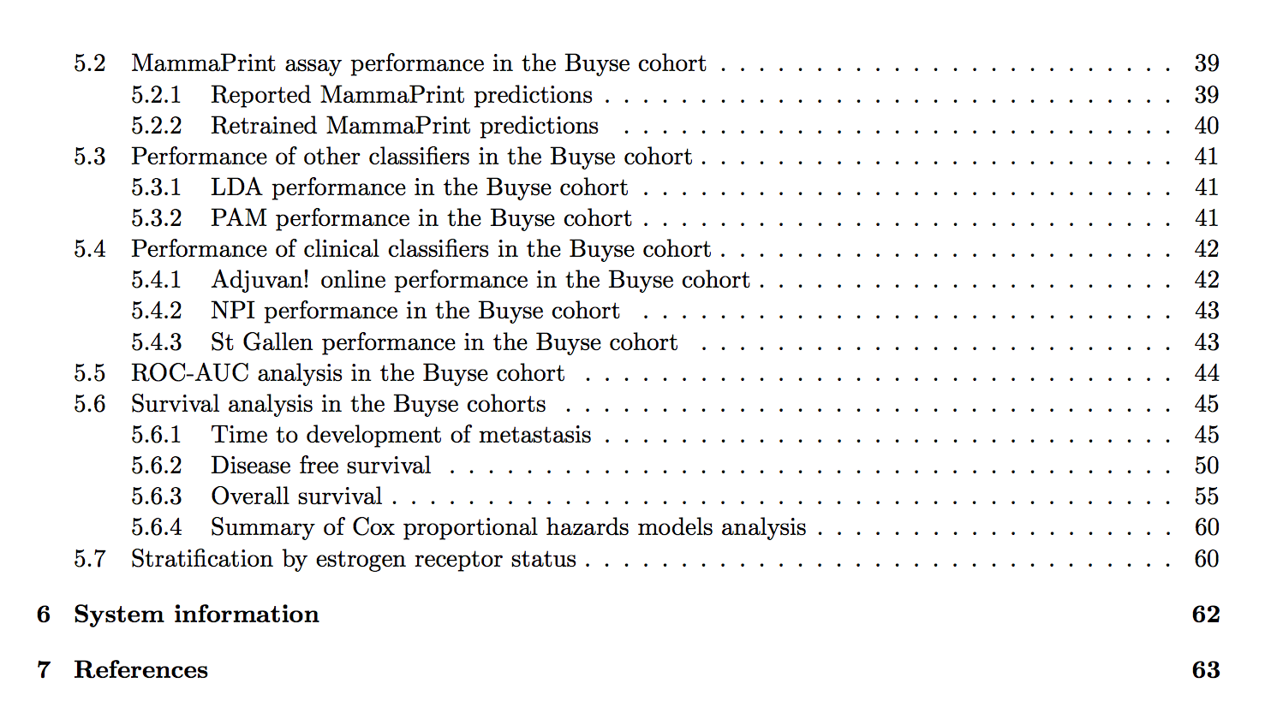
should we automate all this?
Supplement to Marchionni et al. BMC Genomics 2013

Slide 67

“hacking” statistics

Slide 68
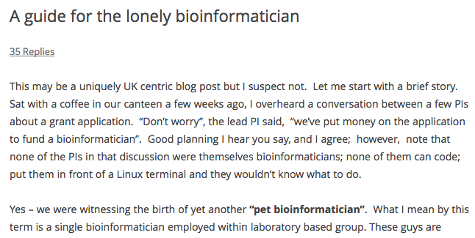
the lonely bioinformatician
http://bit.ly/10vS1yt

Slide 69
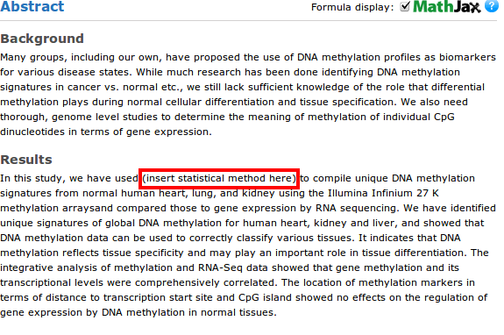
what can easily happen
http://bit.ly/OgW3xv

Slide 70
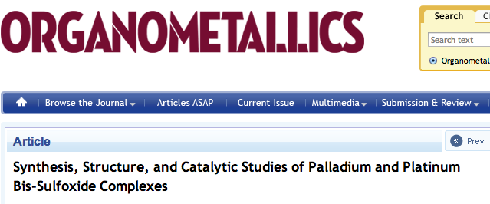
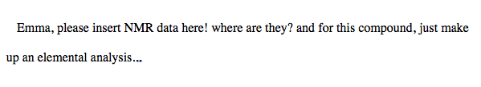
what can easily happen
Drinkel et al. Oganometalics 2013

Slide 71
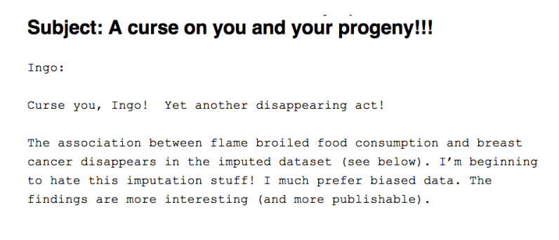
what can easily happen

Slide 72
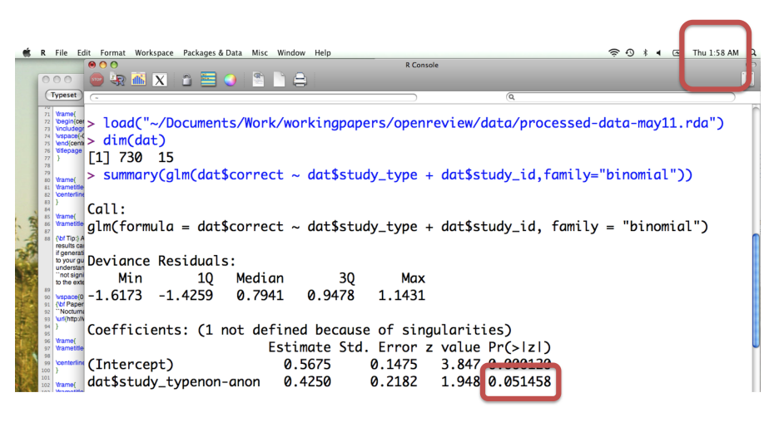
why I’m sympathetic

Slide 73
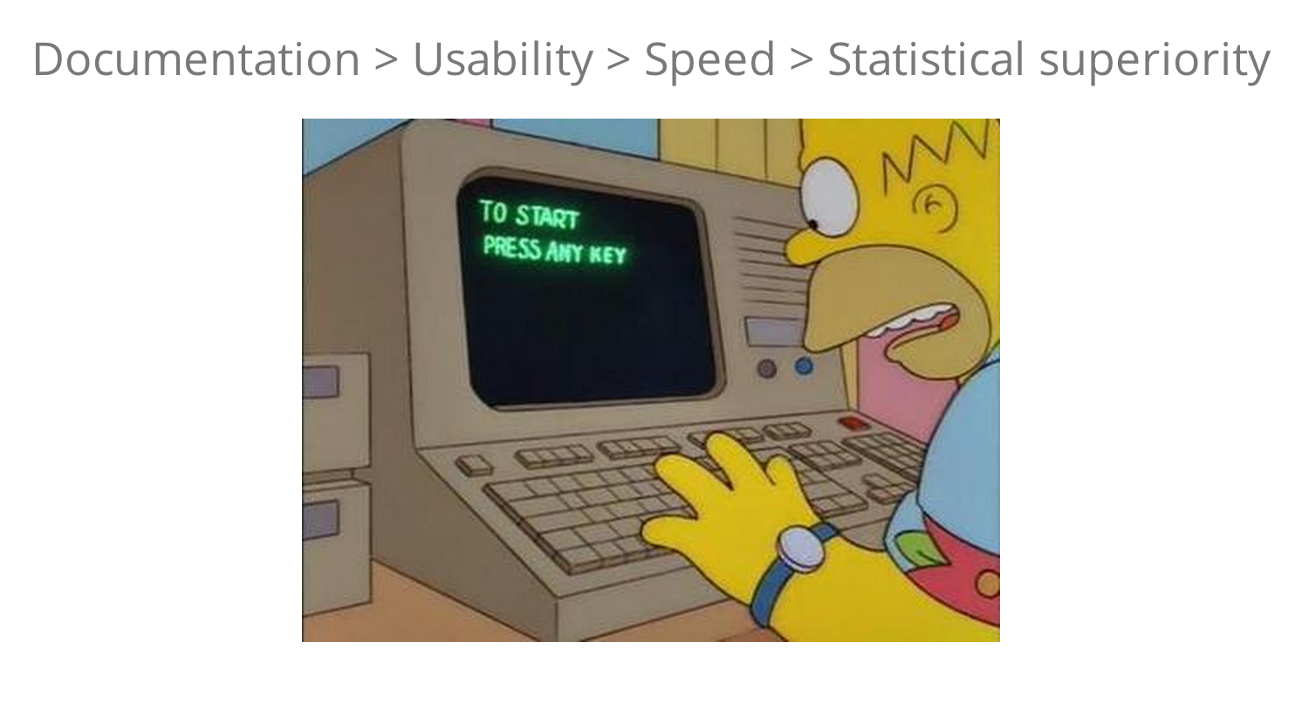
if you want your software used
http://bit.ly/17pGTRN

Slide 74
a deterministic statistical machine for signature development
Inputs
Discovery CEL file directory
Discovery META file
Must have variables: outcome, CEL names, (survival time)
Validation CEL file directory
Validation META file
Must have variables: outcome, CEL names, (survival time)
Outputs
R markdown file
HTML report
Locked down function
Interactive personalized website

Slide 75
steps in the machine
Load the data
Preprocess gene expression
Merge the phenotype + expression
Get batch information
Check for study design problems
Perform fsva
Split training data set into discovery/test
Build predictor on discovery, try on test
Pick number of pairs based on test
Apply to validation data
Create and save predictive function
Create and save interactive visualization

Slide 76
a partial list of issues
Batch – listed or scanned
Normalization – platform dependent
Rawfiles – naming convention
Merging – filenames
Naming survival variables
Subsetting to which population?
….

Slide 77
back to our demo (how are those legs feeling roger?)

Slide 78
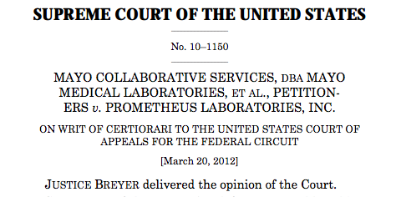
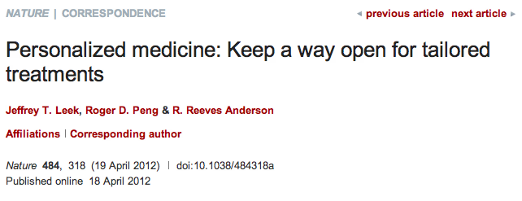
why make it open?
http://simplystatistics.tumblr.com/post/19646774024/laws-of-nature-and-the-law-of-patents-supreme-court

Slide 79
get it while its hot
sva:
https://github.com/jtleek/sva
tspreg:
https://github.com/jtleek/tspreg
rdsmGeneSig:
https://github.com/jtleek/rdsmGeneSig
healthvis:
http://healthvis.org/

Slide 80
acknowledgements
Hopkins
Roger Peng
Ben Langmead
Sarven Sabunicyan
Luigi Marchionni
Donald Geman
Funding
Amazon Web Services
Digital Science
NIH
CCNE
Hopkins inHealth
Leek Group
Hilary Parker (alum)
Alyssa Frazee
Prasad Patil
Leo Collado Torres
University of Maryland
Héctor Corrada Bravo
Harvard
Rafael Irizarry
Lieber Institute
Andrew Jaffe

